Slide 1









Bank Industries
Credit Risk Analysis
Presentation - 2024
Nguyen Dinh Dat

Slide 2



Introduction
Object:
Evaluate current loan client’s behavior and indentify trends to increase number of low-risk borrowers.
Focus area:
Analyze customer demographics, financial factors, and loan purposes
Identify high-risk profiles and growth opportunities
Key Recommendations:
Targeted marketing for low-risk segments
Age-specific loan products
Enhanced risk controls for business and vacation loans
Dashboard for real-time trend monitoring

Slide 3


Datasets
12 columns ; 32.581 rows
person_age: Age of the individual applying for the loan.
person_income: Annual income of the individual.
person_home_ownership: Type of home ownership of the individual.
person_emp_length: Employment length of the individual in years.
loan_intent: The intent behind the loan application.
loan_grade: The grade assigned to the loan based on the creditworthiness of the borrower..
loan_amnt: The loan amount requested by the individual.
loan_int_rate: The interest rate associated with the loan.
loan_status: Loan status, where 0 indicates non-default and 1 indicates default.
loan_percent_income: The percentage of income represented by the loan amount.
cb_person_default_on_file: Historical default of the individual as per credit bureau records.
cb_preson_cred_hist_length: The length of credit history for the individual.

Slide 4





Introduction
______Step by step_____
Processing Data
Risk Analysis
ML Models
Summarize
Example Dashboard

Slide 5


Data Processing
Prepare
Standard
Cleaned data by removing duplicates, handling missing values (via imputation), and standardizing variables like loan amounts, age
Standard data by transform data like: percent income, income group, age group, loan grade.

Slide 6

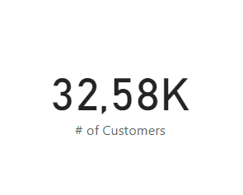
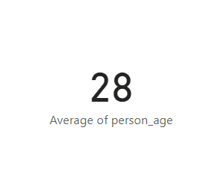
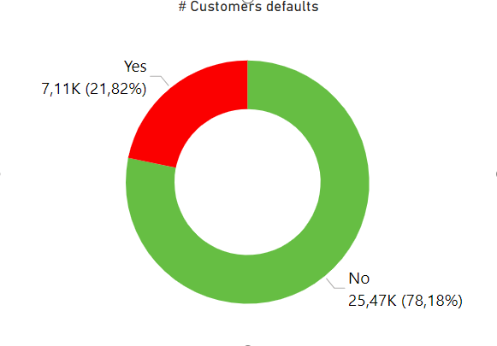

Overview
Over 32K Customers
Average customer’s age is 28
21,82 %
Customer Default

Slide 7
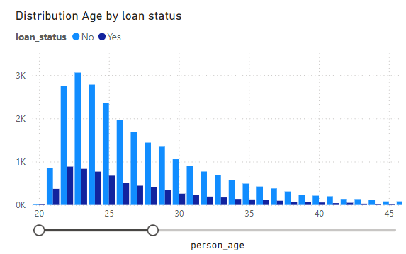

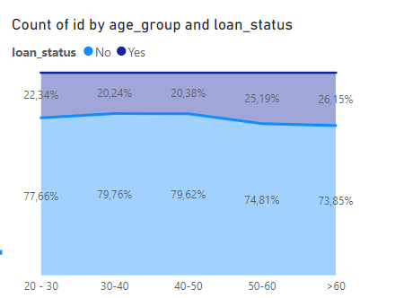

Risk Analysis
Effect Age
21-35
customer files account for a large number
>60
customer group with the highest risk

Slide 8
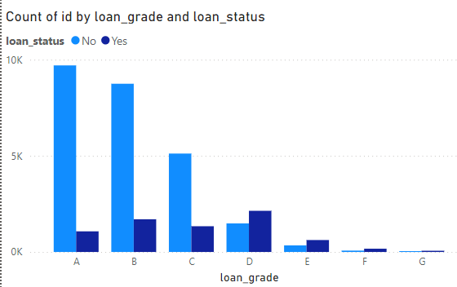
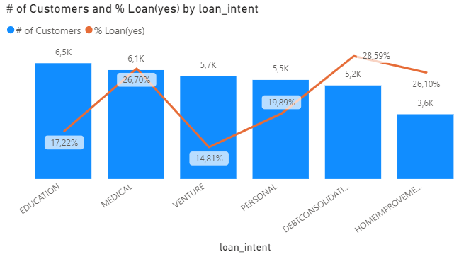
Risk Analysis
Loan Grade & Loan Intent
D
Customers with a credit score below D are often considered high-risk
Medical & Debt consolidation
are high-risk loan purposes

Slide 9
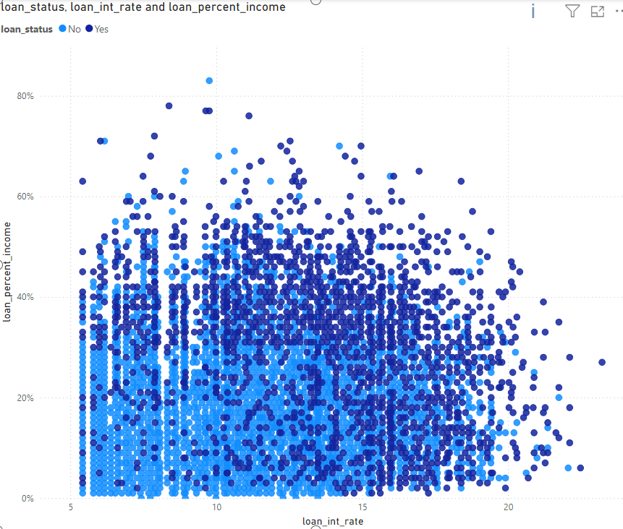
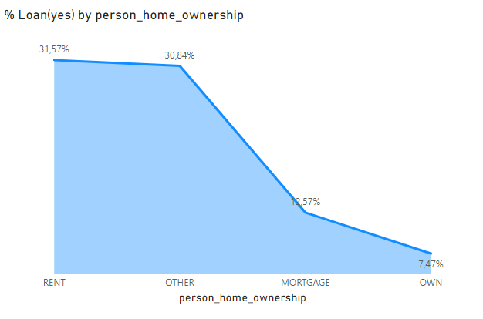
Risk Analysis
Customer Income
When the interest rate exceeds 10% and the loan accounts for 40% of their income, the risk of default significantly increases.
Customers are renting house => highest risk

Slide 10
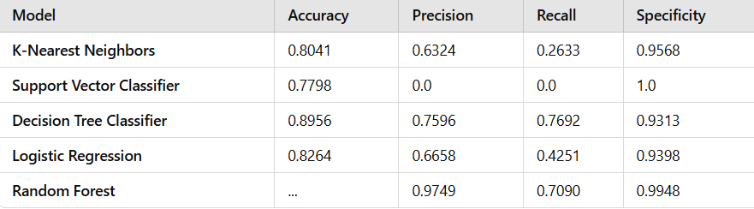
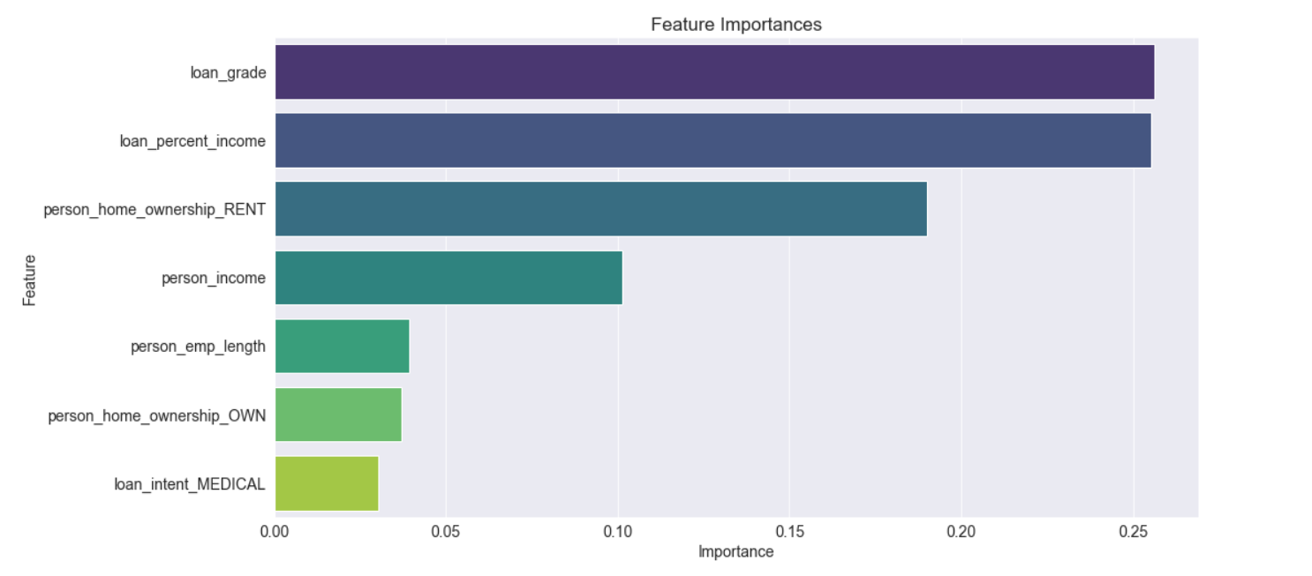
Machine Learning Models
Decision Tree Best Model (Recall = 0,77 ) highest
Some key features identified by the model as important for predict credit risk include: loan_grade, income, rent home

Slide 11

Summarize and Recommandation
Young individuals under 25 and seniors over 60 are high-risk borrowers – additional criteria are needed to mitigate risks.
Prioritize customers with high credit scores
Carefully assess borrowers whose loans exceed 40% of their income and do not own a home.
Leverage advanced technologies to enhance risk prediction and mitigation.
Implement regular credit score reviews to ensure up-to-date risk assessments.
Offer tailored financial products for high-risk groups to better manage their debt.

Slide 12
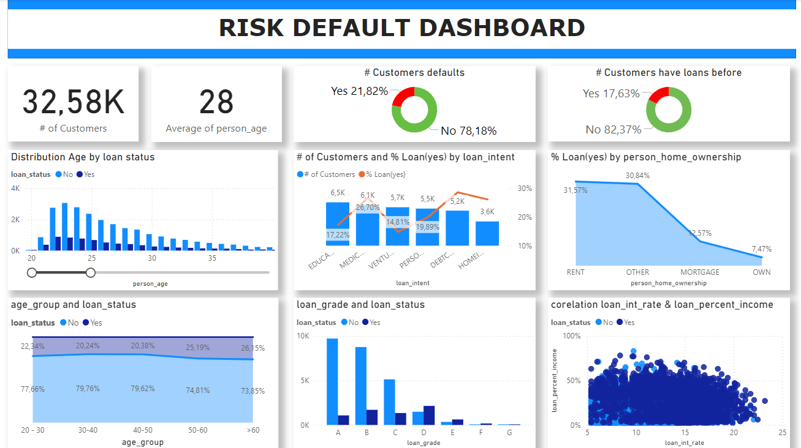
Dashboard Example

Slide 13







Contact Us
I am Đạt, with expertise in data analysis and processing. I have always been passionate and dreamed of working in the field of financial data analysis. I sincerely hope to have the opportunity to collaborate with you.
0865088682
https://www.linkedin.com/in/dinhdatdth/
dinhdatdth@gmail.com
Minh Khai, Hai Ba Trung, Hanoi

Slide 14

Bank Industries
Thank You
For Your Attention
Nguyen Dinh Dat

